Slide 1
dashboardify
Irmantas Ivanauskas, Žygimantas Žilevičius, Martynas Kadiša

Slide 2
About us

Slide 3
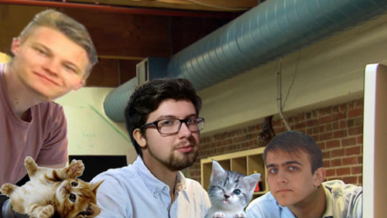
THE FELLOWSHIP OF THE CODE
Žygimantas
Irmantas
Martynas
Kittens

Slide 4
Working in a team

Slide 5

Before

Slide 6

Before
Uncharted lands with loads of tools and frameworks

Slide 7

Before
New workplace

Slide 8
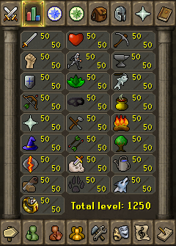
Before
New people with different skillsets

Slide 9
aFTER
Familiarity with tools and frameworks

Slide 10
aFTER
Everyday fun activities at work

Slide 11
aFTER
Utilizing each other’s specialties

Slide 12
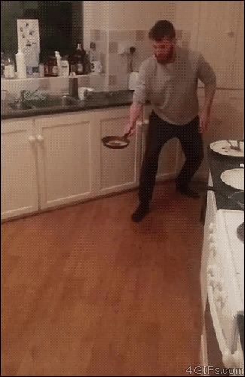
aFTER

Slide 13
the project

Slide 14

IDEA
Who is this for?
For users who are searching for an easy to use web scraping tool
What does it do?
Track content changes in a website
Dashboardify

Slide 15
Challenges

Slide 16




Deciding stack
Vs
SQL NoSQL?
Regular webpage, Backbone, React or something else?
Vs

Slide 17


Deciding stack
Vs

Slide 18
aRCHITECTURE

Slide 19
Rough sketch

Slide 20
tECHNOLOGIES

Slide 21
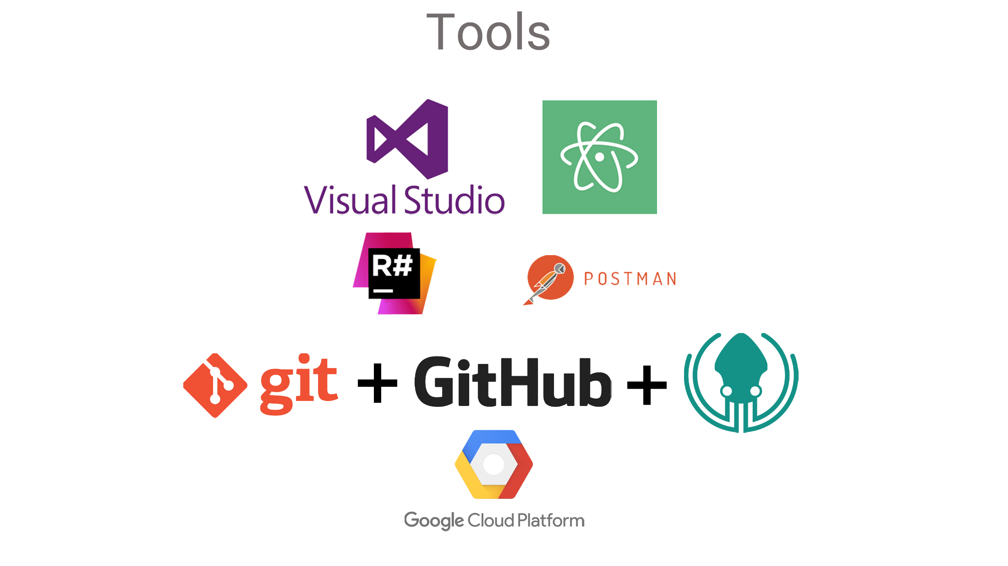

Slide 22

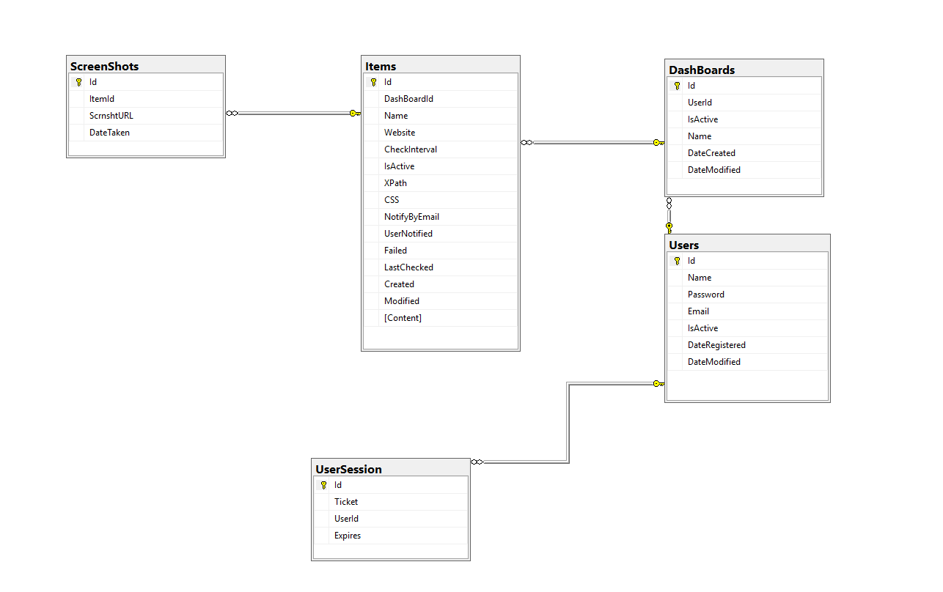
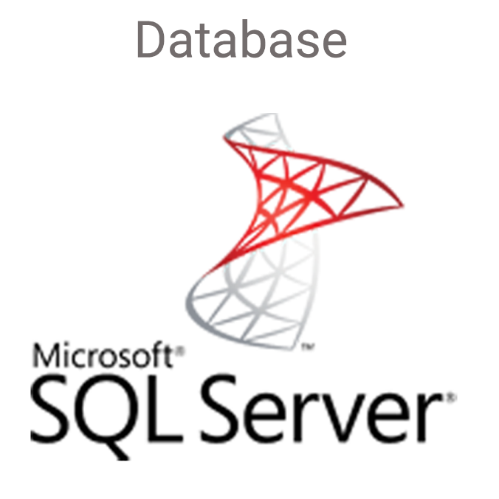

Slide 23
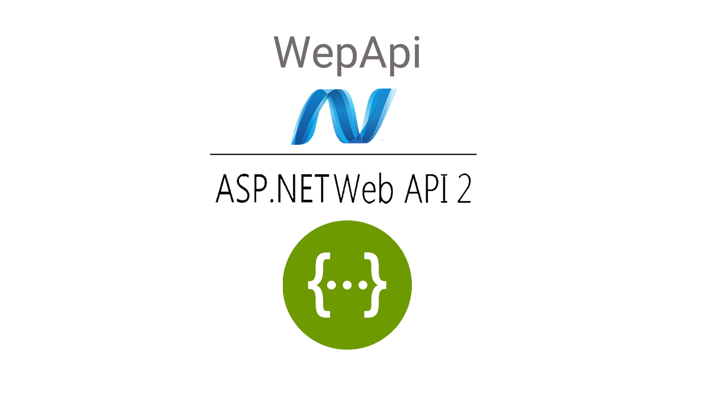

Slide 24
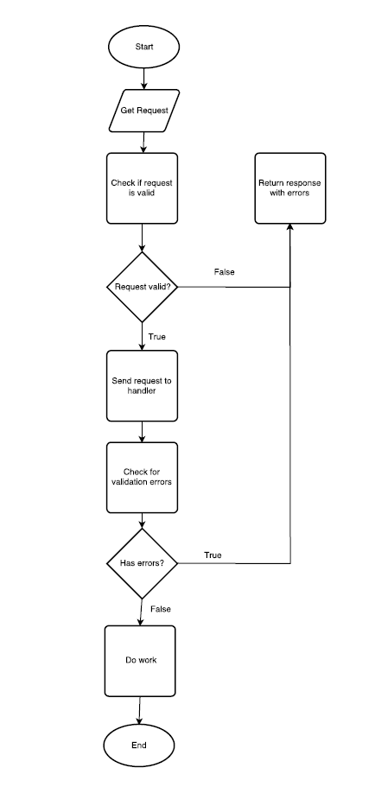

Slide 25
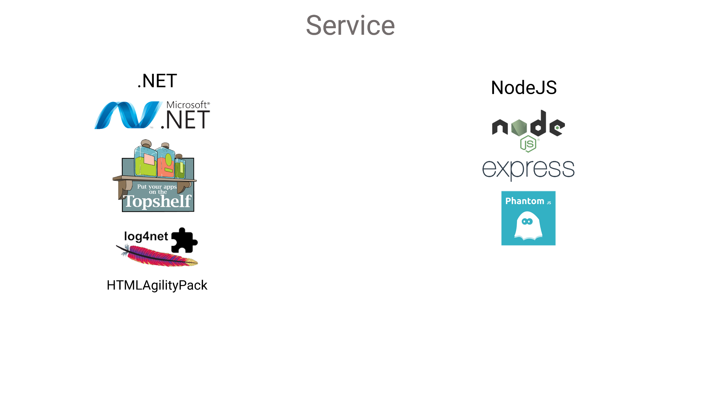

Slide 26
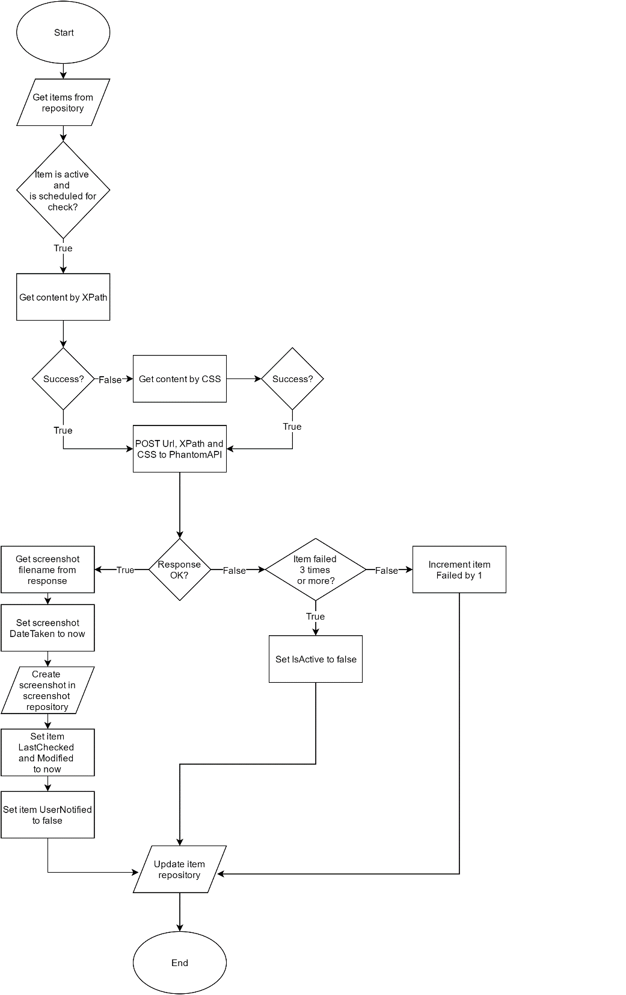

Slide 27
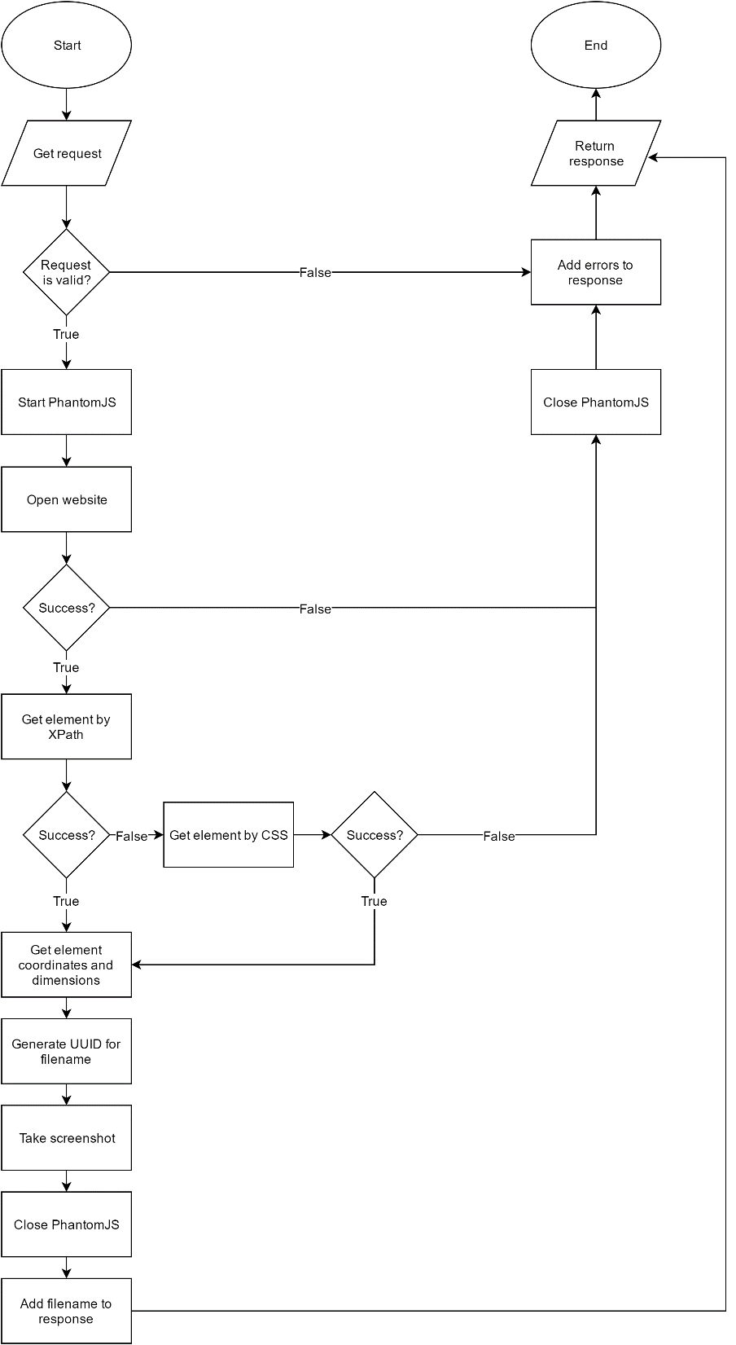

Slide 28
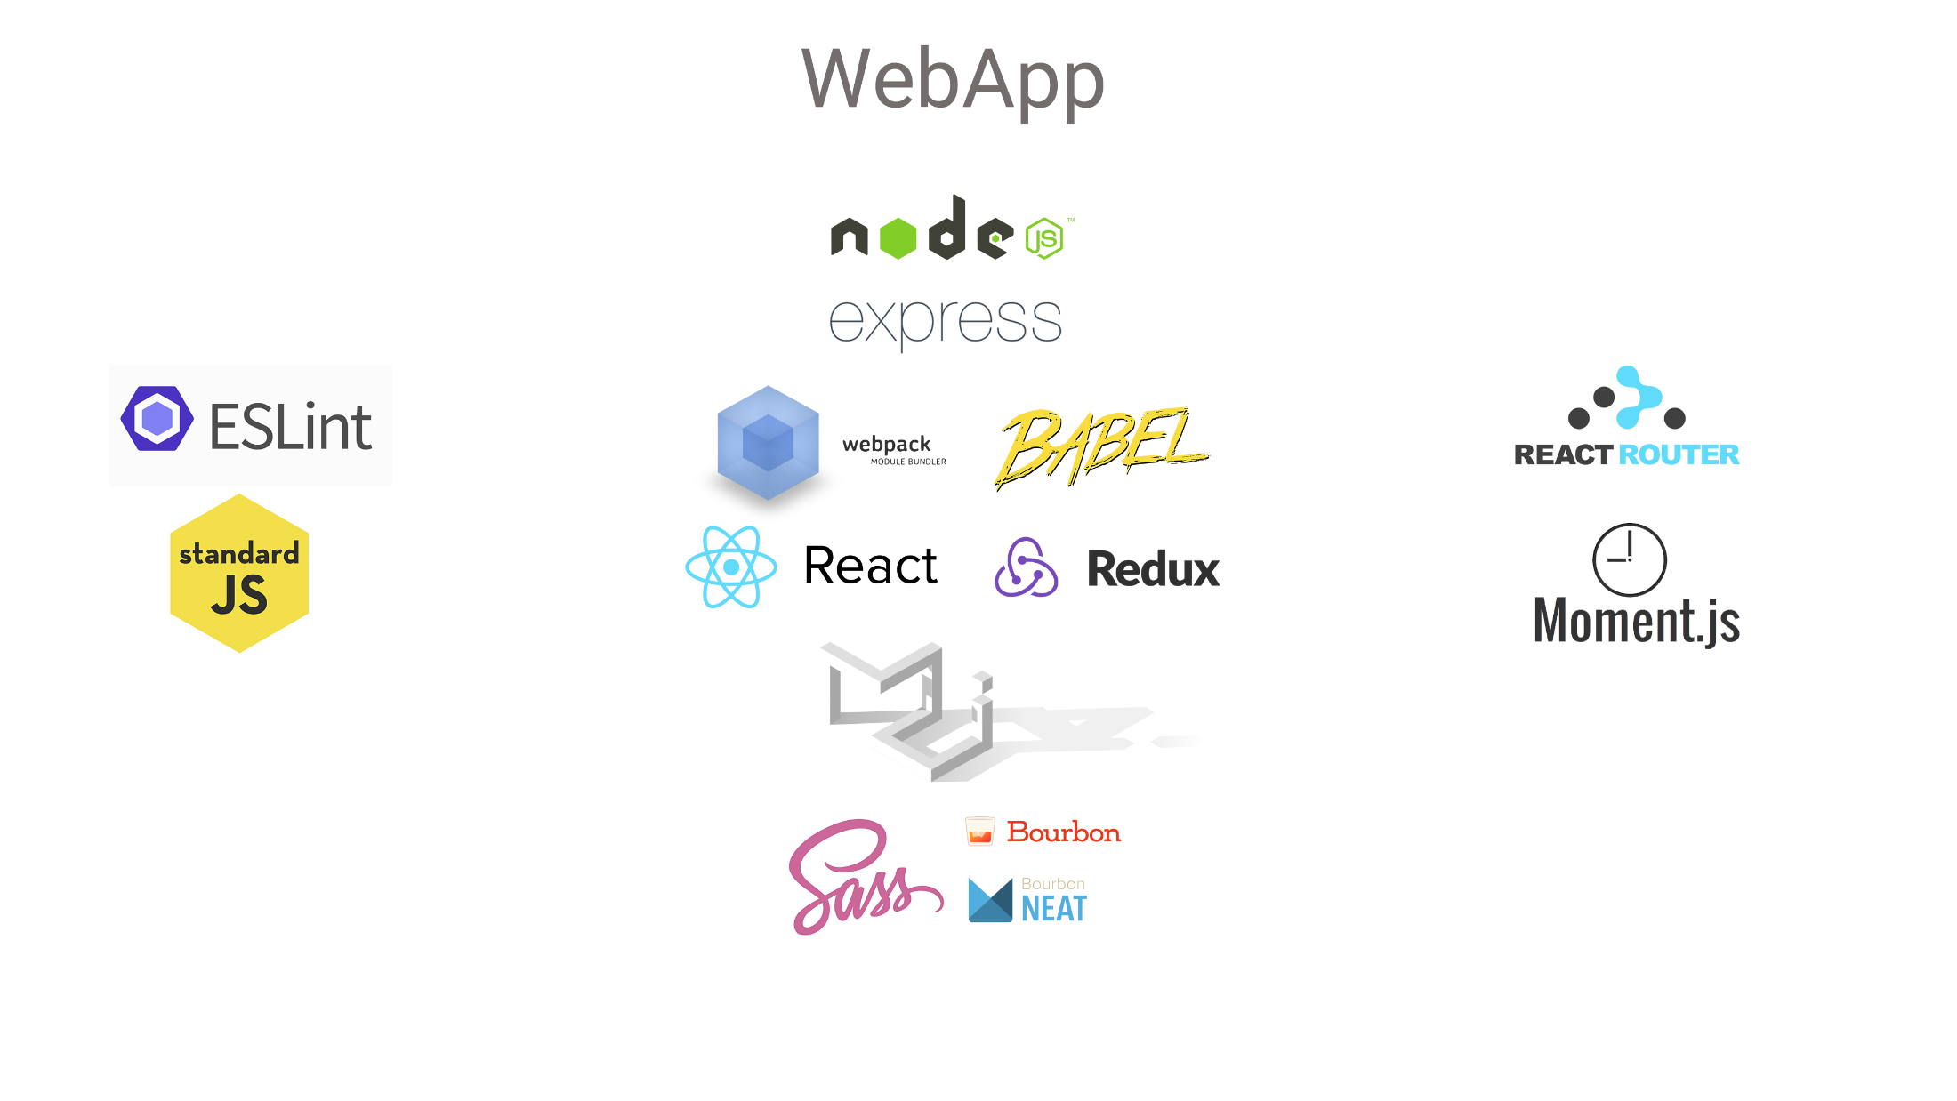

Slide 29
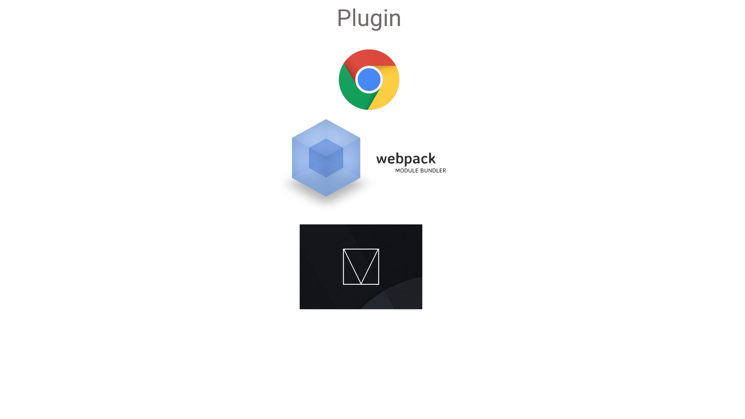

Slide 30
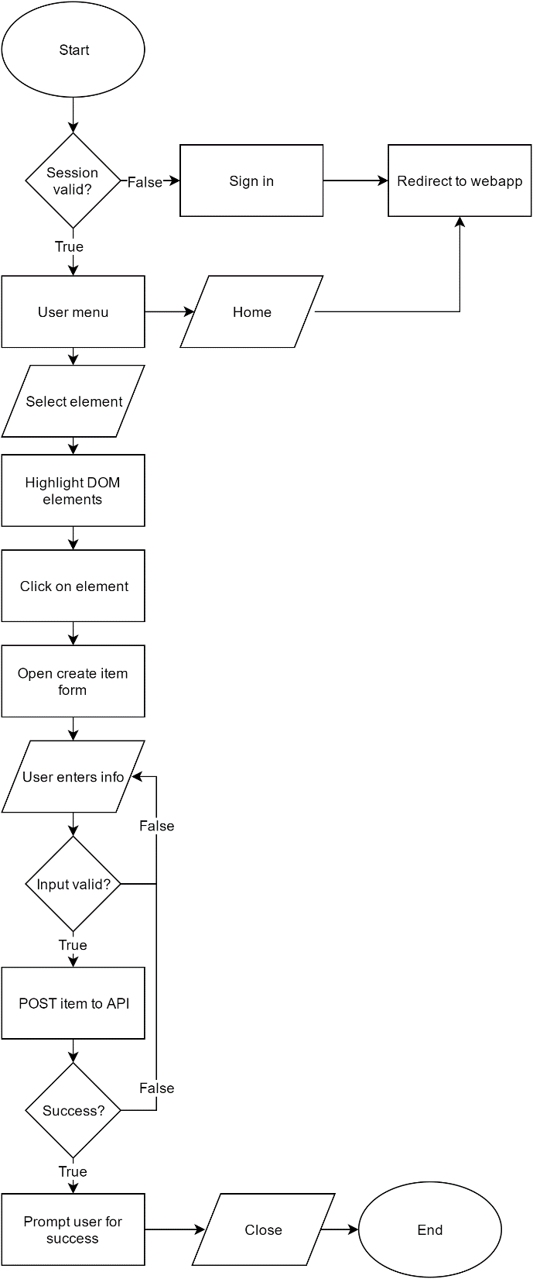

Slide 31
DEMO

Slide 32
tIMELINE

Slide 33
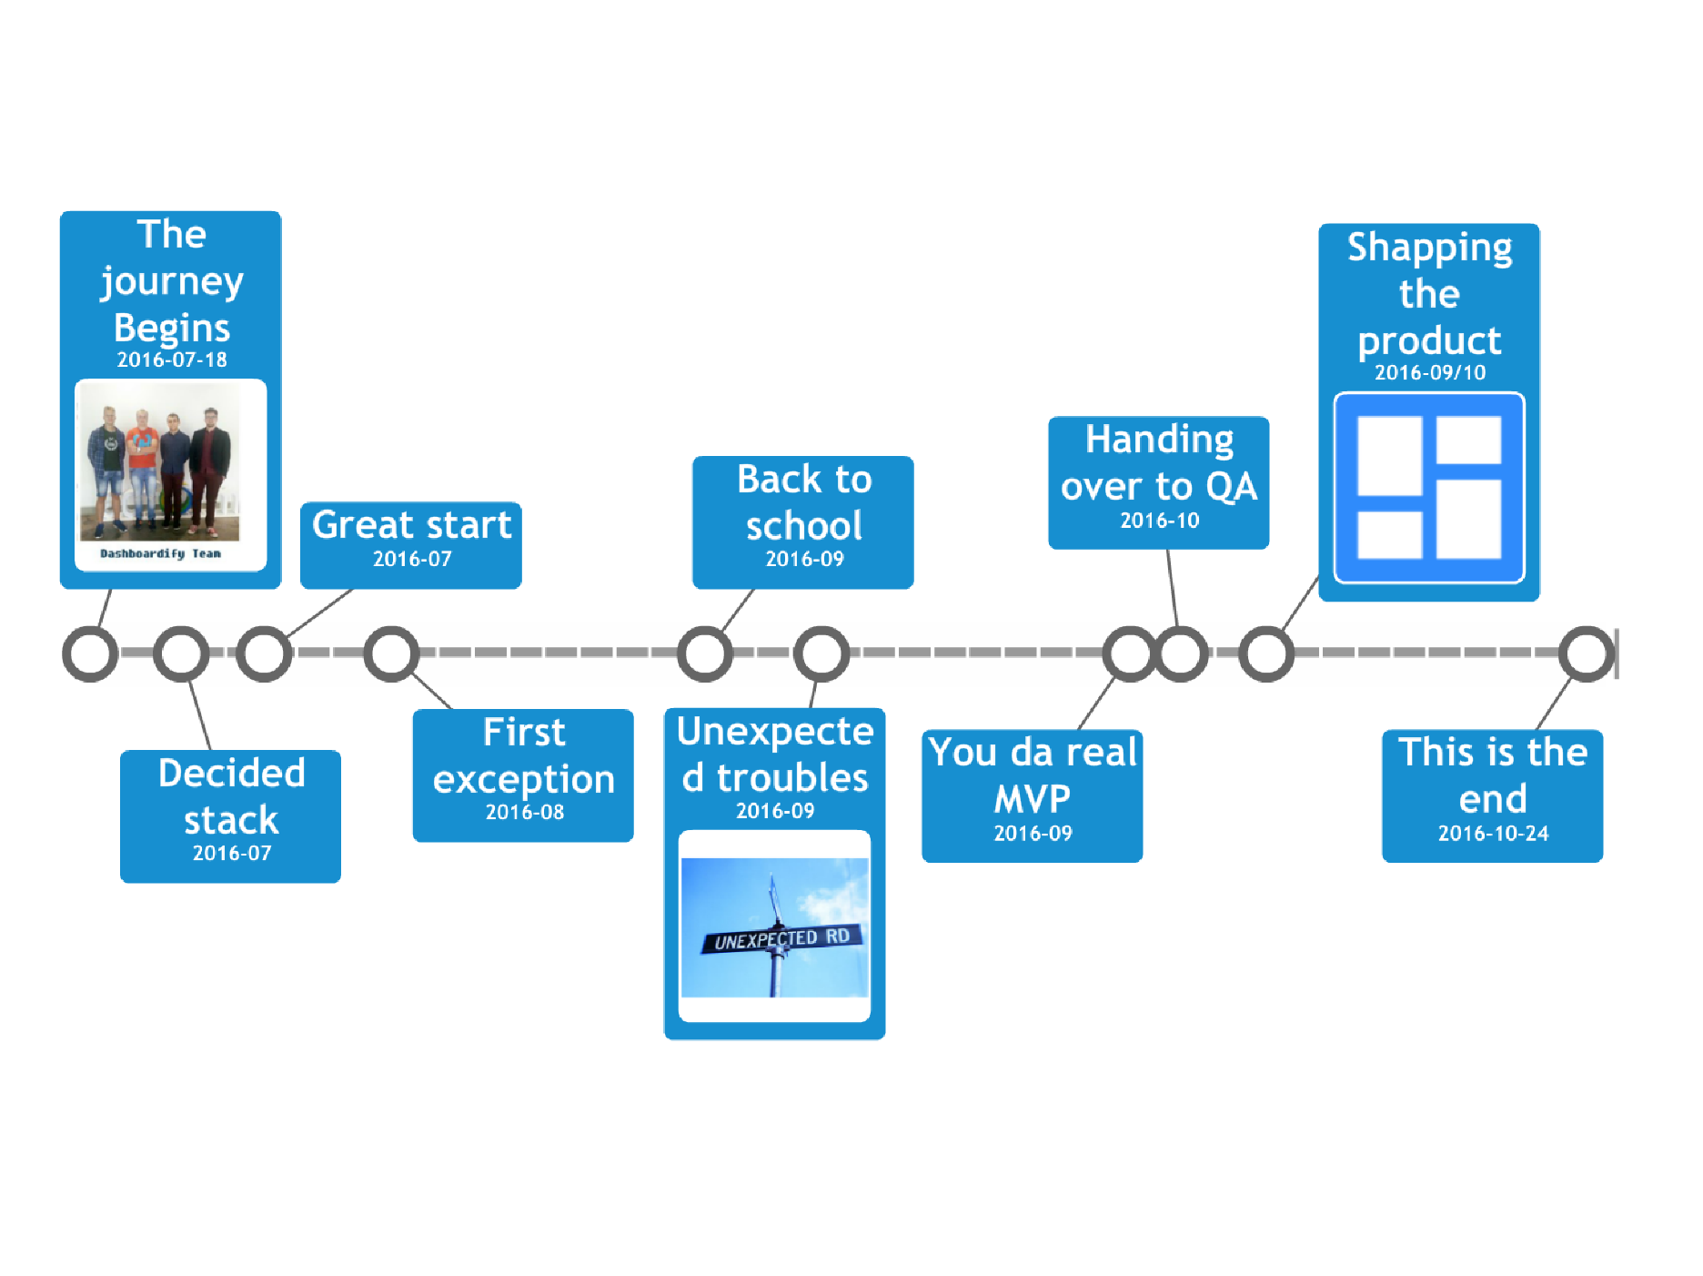

Slide 34
Future improvements

Slide 35
Chrome notifications
Item and dashboard sharing
OAuth logins with Facebook/Google
Real time updates with websockets
Admin menu

Slide 36
What we have learned

Slide 37
Work in a team
Task planning
Coding best practices
Unit testing
Design patterns
Create Windows service
Deploying to production server

